Slide 1


Slide 2

Windows OS – Life Hacks by Sami Laiho

Slide 3
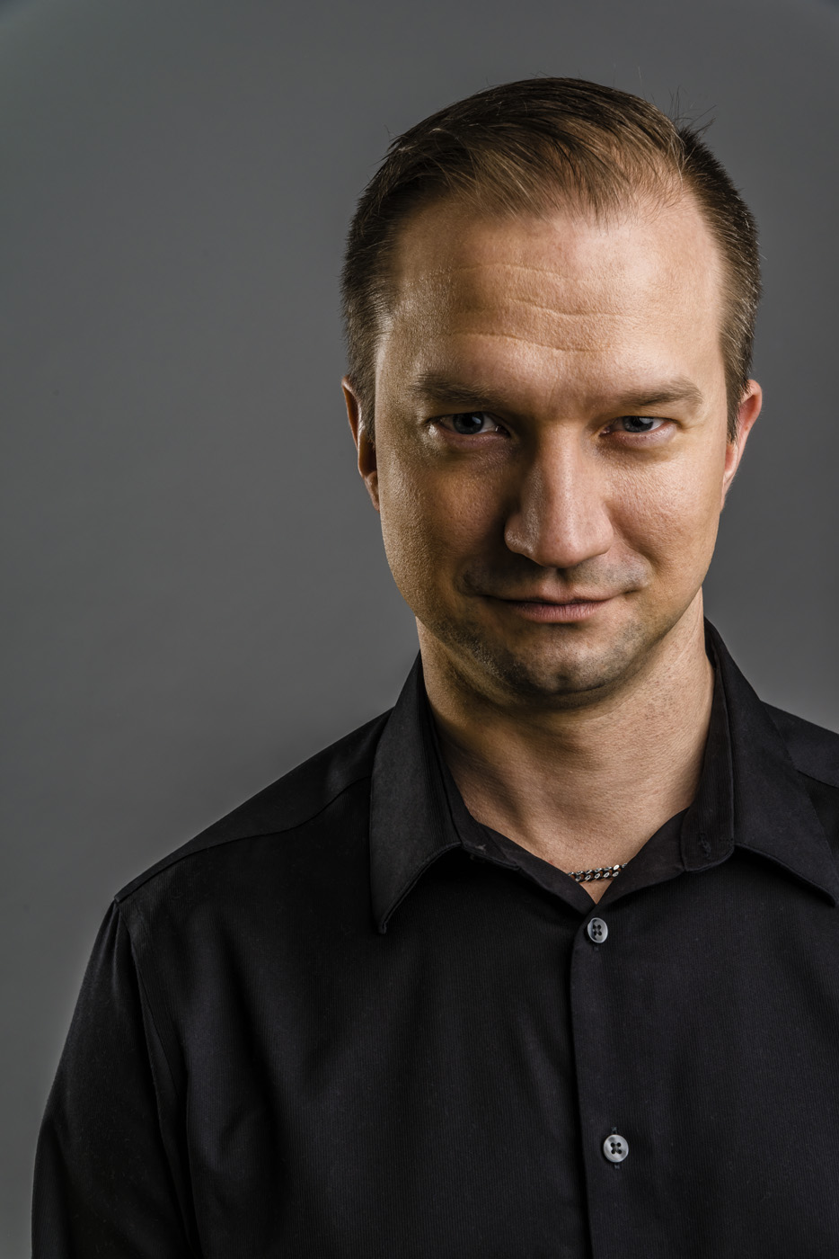
Sami Laiho Senior Technical Fellow adminize.com
IT Admin since 1996
MCT since 2001
MVP in Windows OS since 2011
Specializes in and trains:
Troubleshooting
Windows Internals
Security, Social Engineering, Auditing
Centralized Management, Active Directory
Trophies:
Ignite 2018 – Session #1 and #2 (out of 1708)
Best External Speaker at Ignite 2017
Best Sessions (#1 and #2) at TechTalks 2017, Helsinki
Best Session at AppManagEvent 2017, 2018, Utrecht
TechDays Sweden 2016, 2018 – Best Speaker
NIC 2016, 2017 - Best Speaker
Ignite 2015 – Best male presenter ;) (#2 out of 1000 speakers)
TechEd Europe and North America 2014 - Best session, Best speaker
TechEd Australia 2013 - Best session, Best speaker
TechEd Europe 2013 - Best Session by an external speaker

Slide 4
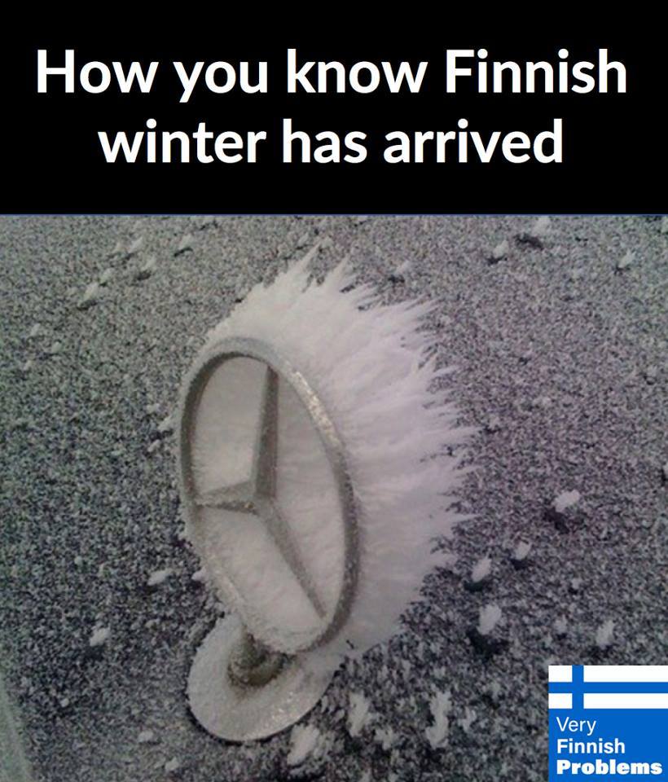
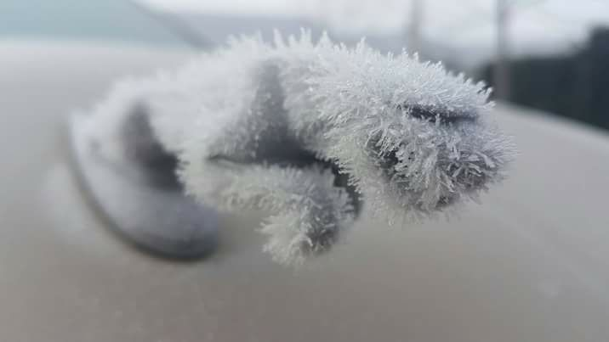

Slide 5
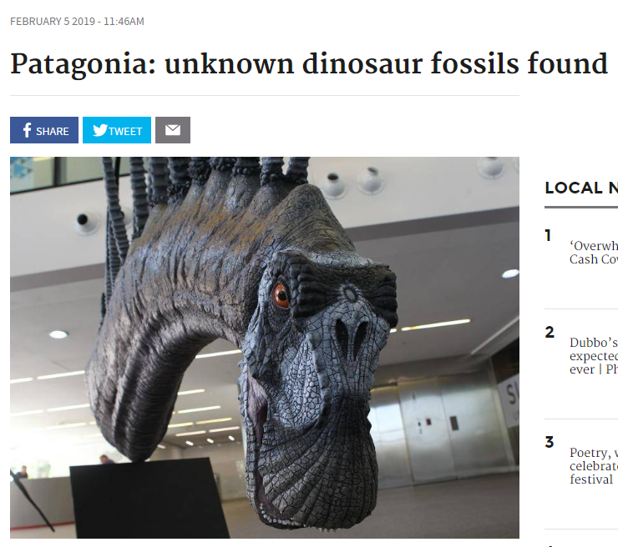

Slide 6

2019 revealed fossils in Finland
Prius
Octavia
Corolla
Polo (aka Mini-Golf)

Slide 7

This session
Is demos only!
Hold tight!

Slide 8
Slides and demos from the conference will be available at
https://github.com/nordicinfrastructureconference/2019

